Slide 1

COST FinAI annual meeting
September 27-28, 2023
Scientific Center of Innovative Research, Estonia

Slide 2
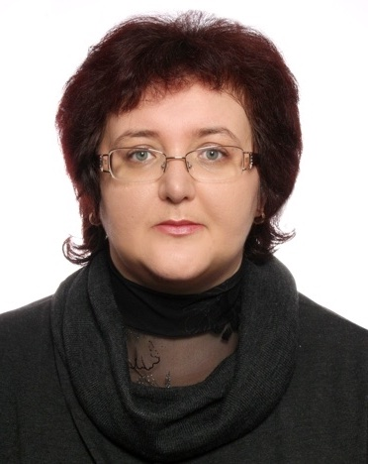
MC Members:
Iryna Mihus
Coauthors and potential members:
Zinaida Zhyvko
Scientific Center of Innovative Research
Phd (Economics), Professor
Interdisciplinary background :
Anti Fraud, Blockchain
Dr.S. (Economics), Professor
Director, Scientific Center of Innovative Research, (Estonia)
Visiting Prof., KROK University (Ukraine)
irynamihus@gmail.com
office@scnchub.com

Slide 3
Contribution:
Papers and presentations:
Mihus, I. (2023). The main trends in the development of industry 4.0 and its impact on the economic security of the state: an international aspect. Science Notes of KROK University, (1(69), 52–59. https://doi.org/10.31732/2663-2209-2022-69-52-59.
Mihus, I., Gupta, S.G. (2023). The main trends of the development of the digital economy in the EU countries. The development of innovations and financial technology in the digital economy: monograph. OÜ Scientific Center of Innovative Research. 2023. 230p.PP. 23-41, https://doi.org/10.36690/DIFTDE-2023-23-41.
Mihus, I., Shakhatreh, H.J.M. (2023). The main trends in the development of blockchain technologies and the prospects for their use to protect fraud. The development of innovations and financial technology in the digital economy: monograph.OÜ Scientific Center of Innovative Research. 2023. 230p. PP. 207-229. DOI: https://doi.org/10.36690/DIFTDE-2023-207-229.

Slide 4
Contribution:
In printing
Sandeep Kumar Gupta, Anoop Kumar, Deepa Rajesh, Neha Nagar, Fatima Qasim Hasan, Iryna Mihus (2023), The parameters that influence the achievement and letdown of performance management schemes in major enterprises in India's manufacturing industries, Intelligent Systems, Business, and Innovation Research (USA journal from the Scopus list)

